Slide 1
Welcome and Introduction
Colville, WA Spoke & Hup Tour
September 14 – 16, 2018
Gerry Bergstrom

Slide 2
Discussion Points
Concept
Location
Group Dinner
Weather in Colville in Mid September
Overnight accommodations –
Arrival Date:
day one ride start
Ride Start Date: day two
Last day: day three
Getting to the start : Eastern Washington Fair Grounds
SAG support & Satellite Phones
Links

Slide 3
SBC Tour Hub and Spoke Concept
Routes eminate from central location
Routes offered based upon distance and pace preferance

Slide 4
Where is Colville, WA
Map and travel time: Click Here
Arrive in time for ride start (10:00 AM shart)
Ride Start: Eastern Washington Fairgrounds (Click HERE)

Slide 5
Group Dinner
Date: September 14th
Day: Friday
Time: 6:00 PM
Location:
Staphanie’s Oakstreet Grill
225 E 1st Ave, Colville, WA 99114

Slide 6
Colville Weather history
Wind speed
Precipitation
Temperatures

Slide 7
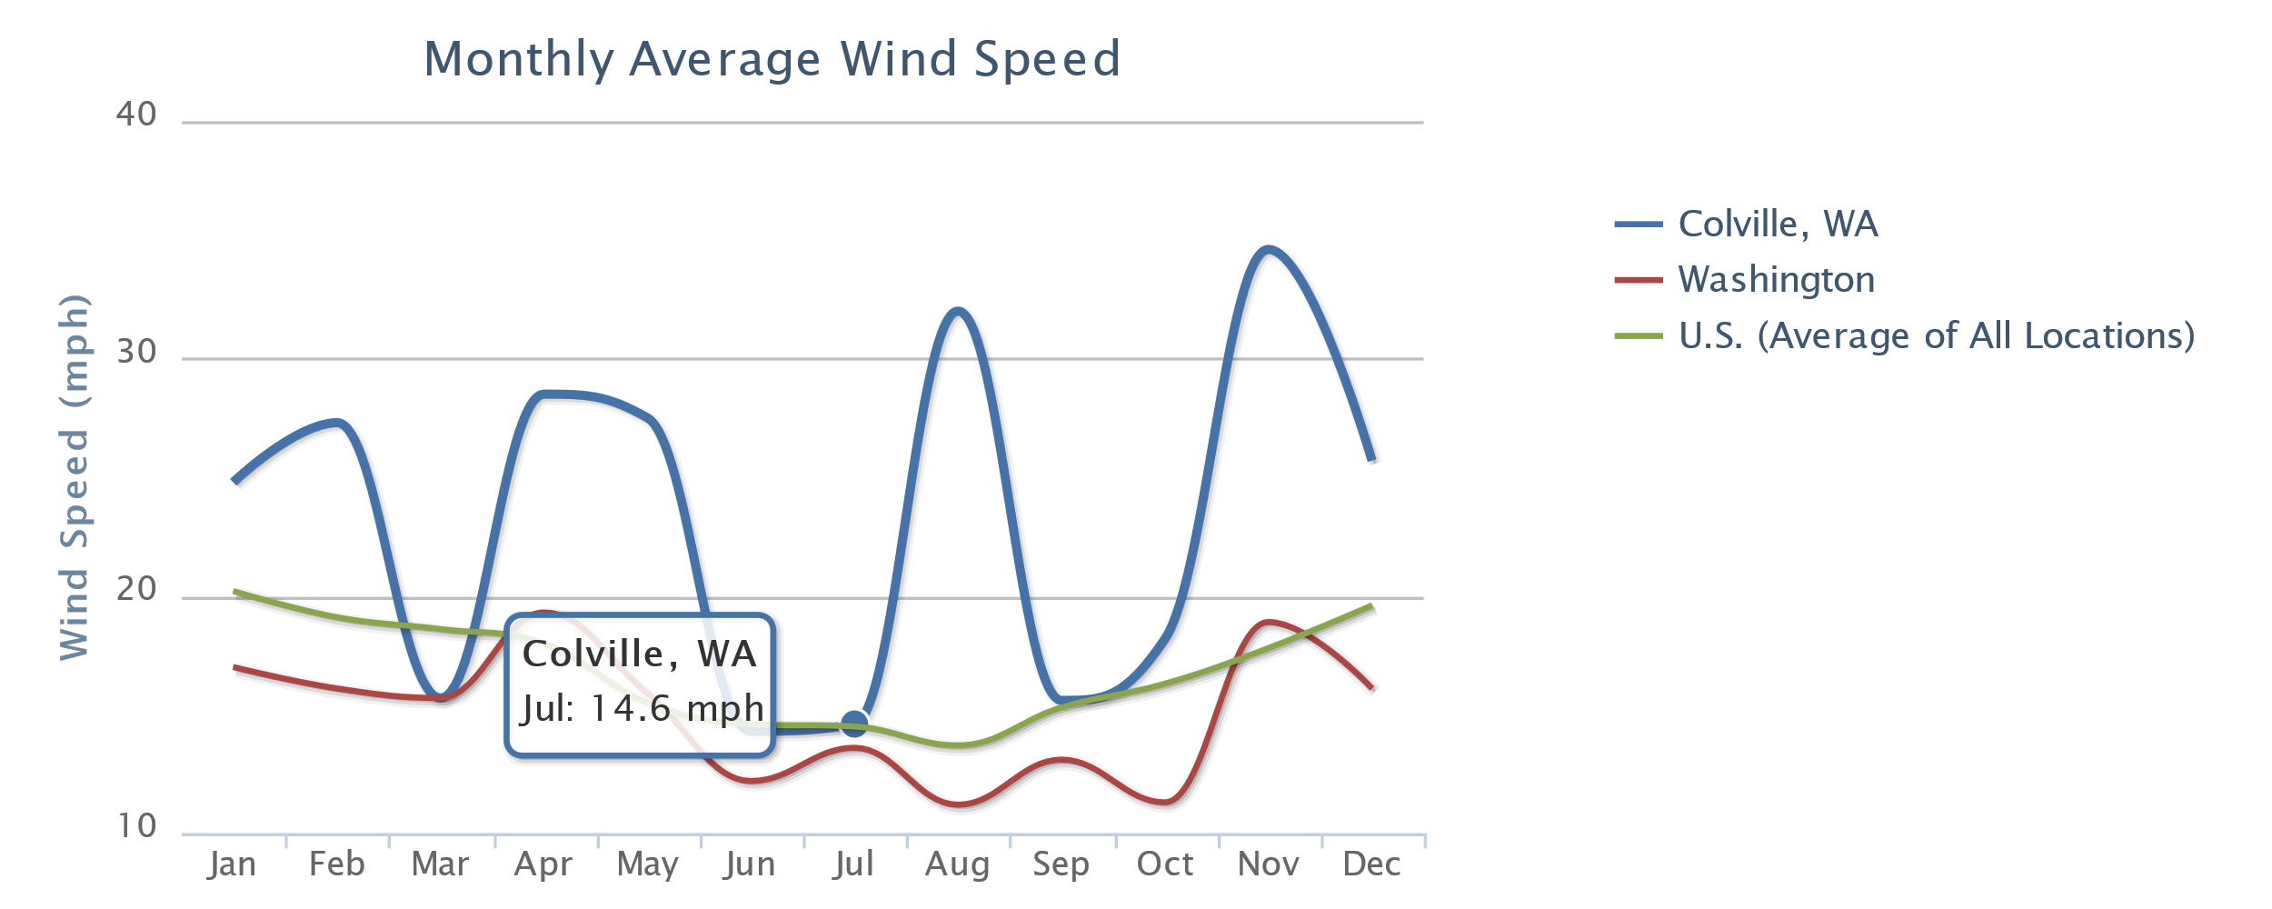
Average Wind Speed

Slide 8
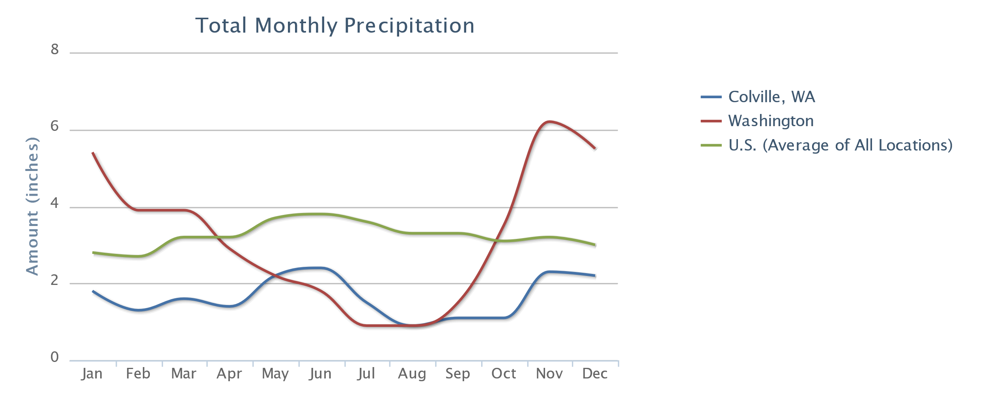
Average Rain Fall:

Slide 9
Average Temperatures
 | Jul | Aug | Sep | Oct | Nov | Dec
Average high in °F: | 87 | 88 | 78 | 62 | 43 | 34
Average low in °F: | 53 | 52 | 44 | 35 | 29 | 21
°C | °F

Slide 10
Accomodations
Benney’s Colville Inn
Comfort Inn
Free Camping: Eastern Washington State Fairgrounds (in town)

Slide 11
Dates
Friday, September 14th.
Ride starts at 10:00 AM at Eastern WA State Fairgrounds (Click HERE)
Group dinner at Stephanie’s Oakstreet Grill (details to follow)
Saturday, September 15th
Ride starts at 9:00 AM at Eastern State Fairgrounds
Sunday, Septermber 16th
Ride starts at 9:00 AM at Eastern State Fairgrounds

Slide 12
Routes
New Item 1
25 to 35 miles and leisurely pace (10 - 12)
40 to 60 miles at steady pace (12 - 14)
New Item 1
25 to 35 miles and leisurely pace (10 - 12)
40 to 60 miles at steady pace (12 - 14)
Route Options: (as advertised)
25 to 35 miles and leisurely pace (10 - 12)
40 to 60 miles at steady pace (12 - 14)

Slide 13
Day one routes
Short Route: Douglas Falls Loop (20.7 miles / 850’ elevation gain
Click HERE for map and cue sheet
Long Route: Williams Lake – Evans Highway Loop (41.5 Miles / 1779 elevation gain
Click HERE for map and cue sheet

Slide 14
Day Two Routes
Short Route: Colville ADDY: 31.5 / 1,213’ elevation gain
Click HERE for map and cue sheet
Long Route: Colvello 48.6: 48.6 miles / 3,233’ elevation gain
Click HERE for map and cue sheet

Slide 15
Day Three Route
Short Route:Colville Valley Route: 26 miles / 904’ elevation gain
Click HERE for map and cue sheet
Long Route: Colvello 37.9 miles / 1694’ elevation gain
Click HERE for map and cue sheet

Slide 16
Links
For planning documents go to Spokanebicycleclub.org home page
Planning meeting document (this presentation)
Route PDFs

